Slide 1
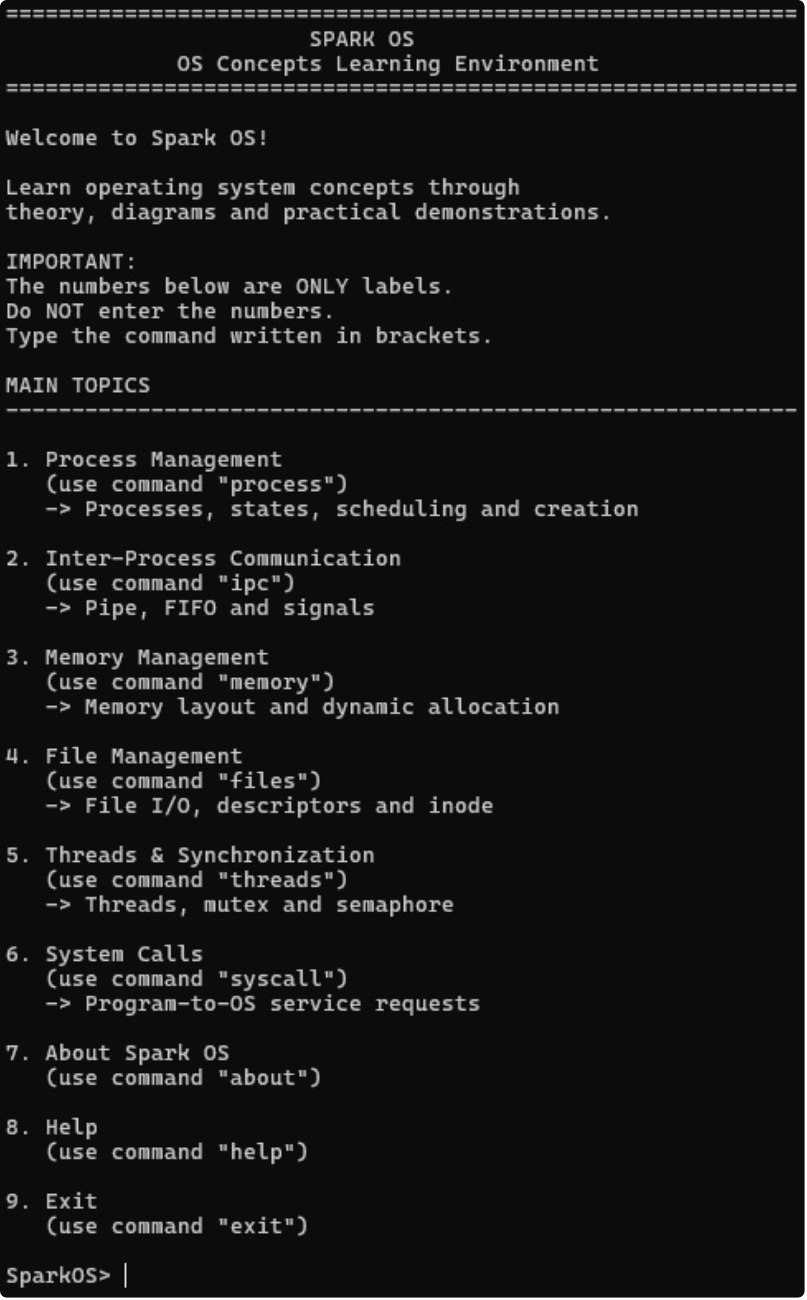
SPARK
OS
FINAL_INTERFACE.PNG
SPARK_OS.TXT
Educational mini-OS
Practical OS concept demonstrations
Command-based learning environment
An Interactive Environment for Understanding Operating System Concepts
THEORY → DIAGRAM → PRACTICAL DEMO → RESULT

Slide 2
Problem & Gap Analysis
GAP
Theory-heavy learning
RESPONSE.TXT
OUR RESPONSE
Students need a simpler way to connect OS concepts with observable execution.
Spark OS combines concepts, diagrams, and practical demonstrations.
→ difficult to visualize → limited practical understanding
GAP | OUR RESPONSE

Slide 3






Final Solution
SPARK_SHELL.EXE
SPARK OS
LEARN → VISUALIZE → EXECUTE → OBSERVE
Process
IPC
Memory
MODULAR
COMMAND-BASED
PRACTICAL
Files
Threads
System Calls

Slide 4
Novelty of Spark OS
Connecting OS theory with visual and executable demonstrations in one learning environment.
LEARNING_LOOP.EXE
Concept
Diagram
Live Result
1
2
3
4
5
Theory
Command
01
02
03
04
Interactive learning
Visual representation
Practical execution
Modular learning environment

Slide 5
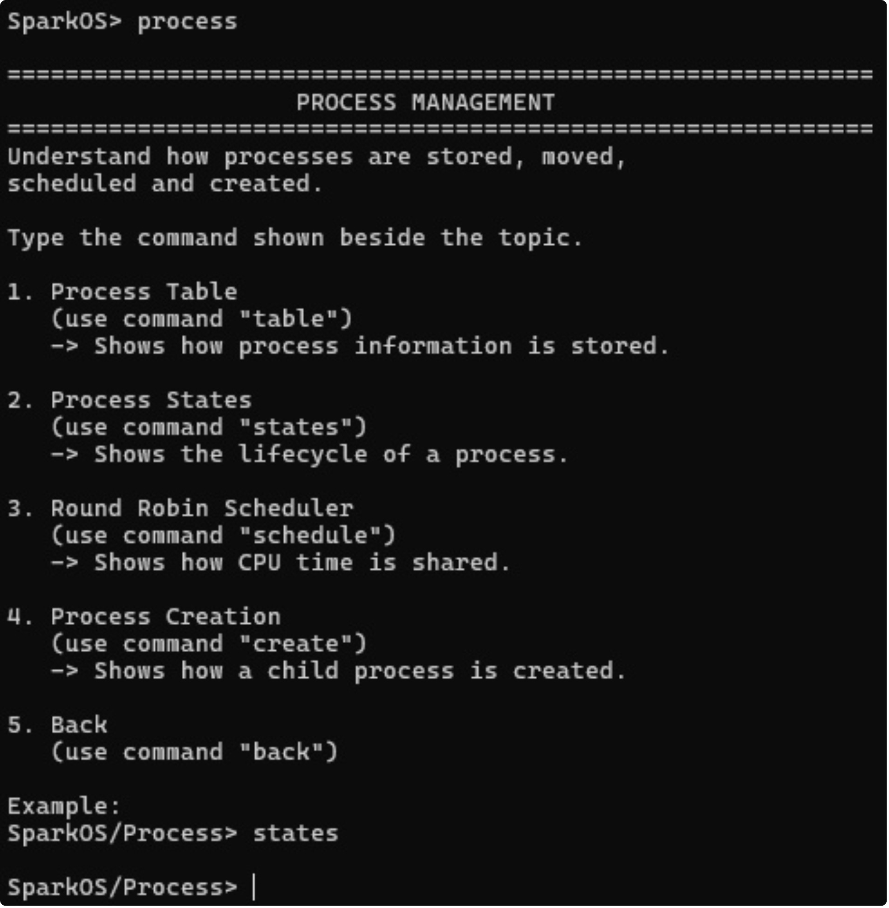

Final System Architecture
INPUT
User
CONTROL
Command-Based Interface
CORE
Spark OS
BOOTABLE MINI-KERNEL ↔ UBUNTU PRACTICAL ENVIRONMENT
TWO COMPLEMENTARY IMPLEMENTATION ENVIRONMENTS

Slide 6
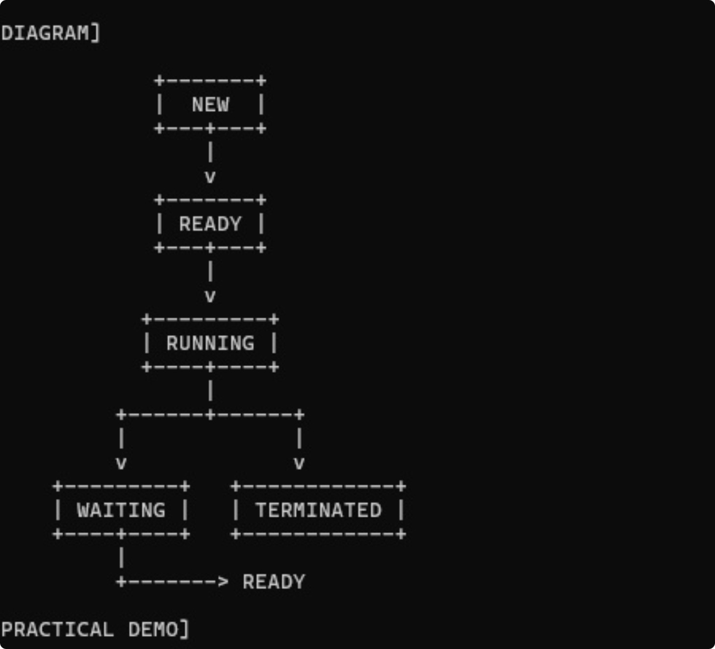
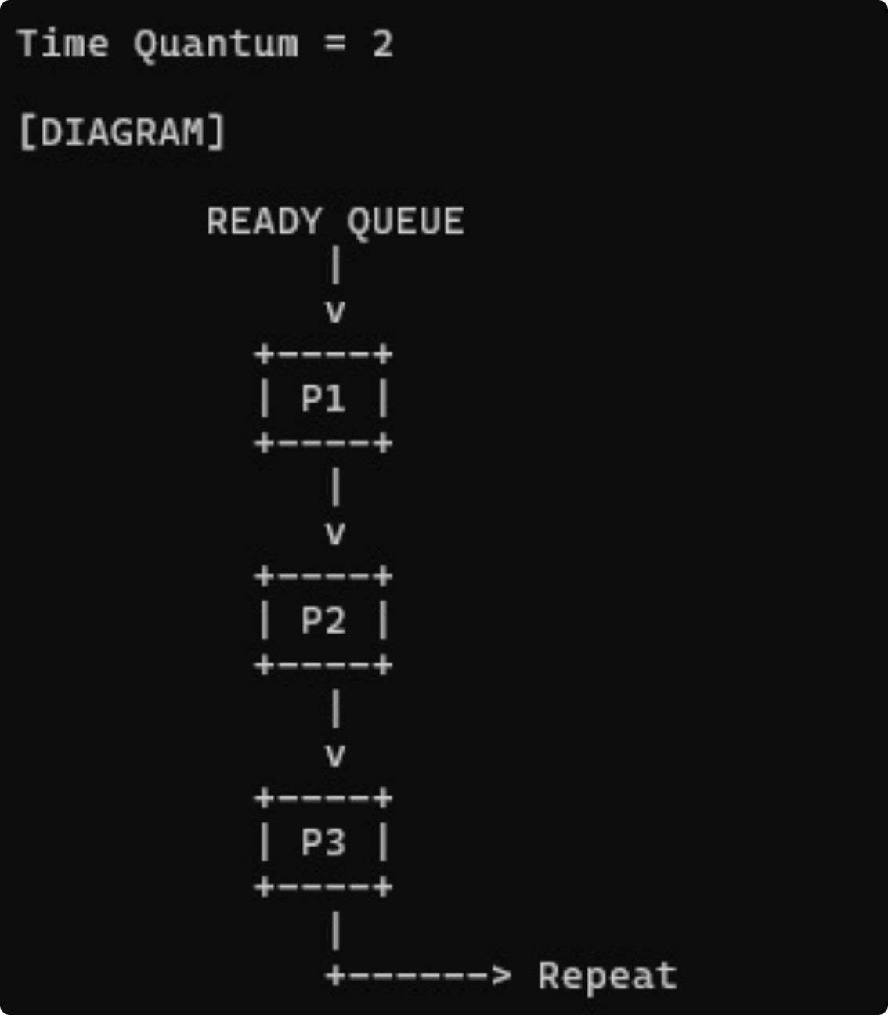
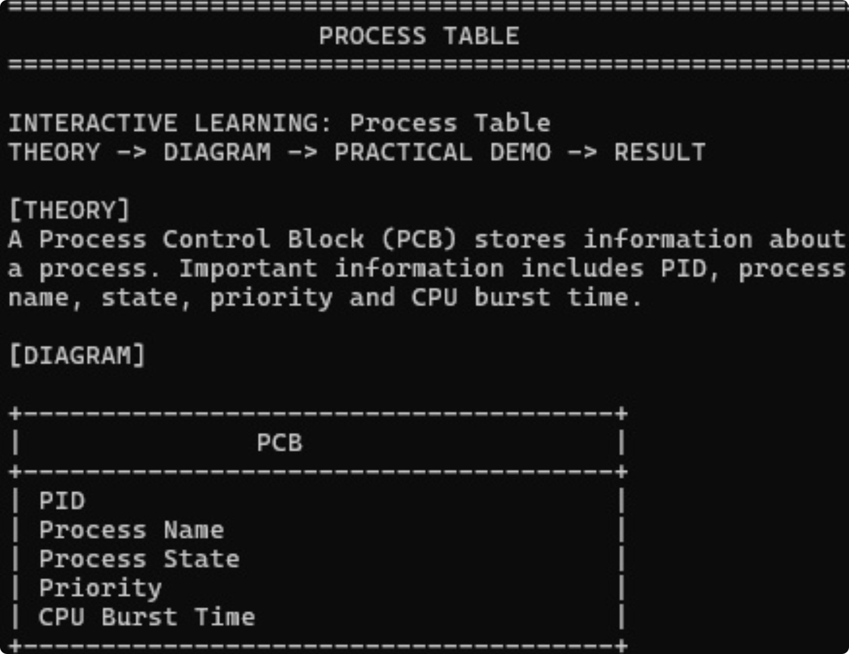
Process Management & Scheduling
Process lifecycle and CPU scheduling are demonstrated through an interactive process environment.
PROCESS_STATES.LOG
New → Ready → Running → Terminated; Ready → Waiting
ROUND ROBIN: P1 → P2 → P3 → P1 → …
INSERT PROCESS STATES SCREENSHOT HERE

Slide 7
OS Concept Demonstrations
MODULES.LOG
IPC
Memory
Files
Pipe · FIFO · Signal
Layout · malloc/free
File I/O · File Descriptor · Inode
Threads
System Calls
Threads · Mutex · Semaphore
Demonstration

Slide 8
Final Working Demonstration
Command → Module → Demonstration → Result
FINAL_RUN.LOG
MAIN INTERFACE
PROCESS DEMO
IPC DEMO
MEMORY / FILE DEMO
SYNCHRONIZATION DEMO

Slide 9
Advantages & Future Scope
CURRENT IMPLEMENTATION
FUTURE EXTENSION
Advantages
Future Work
Beginner-friendly
More scheduling techniques
Interactive
Extended memory simulations
Command-based
Additional filesystem concepts
Visual learning
More IPC mechanisms
Practical execution
More advanced learning interface
Modular
Current Implementation → Future Extension

Slide 10
FINAL_OUTCOME.TXT
SPARK_OS.RESULT
Final Outcome
Educational mini-OS foundation
Theory
→
Understanding
→
Diagram
→
Practical Execution
→
Observable Result
Interactive OS demonstrations
Command-based learning
Modular and extendable platform
THANK YOU
SPARK OS PROVIDES A PRACTICAL AND BEGINNER-FRIENDLY APPROACH TO UNDERSTANDING OS CONCEPTS THROUGH INTERACTIVE DEMONSTRATIONS.

